Slide 1
Figures for Cotranscriptional Splicing Paper

Slide 2
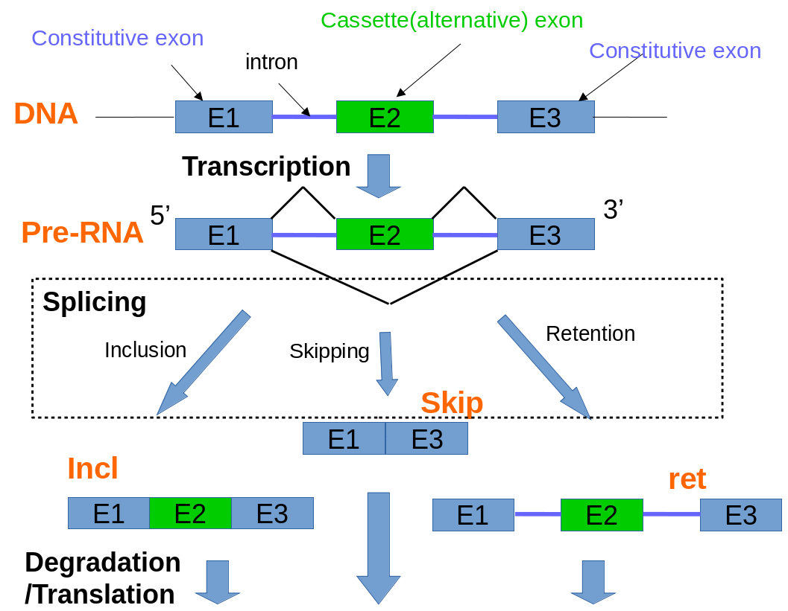
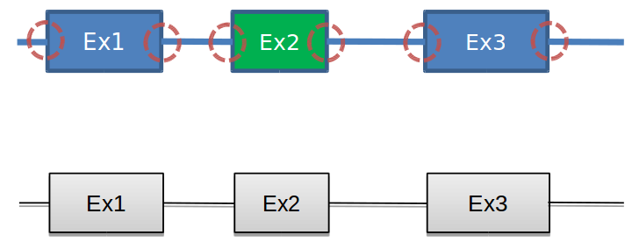
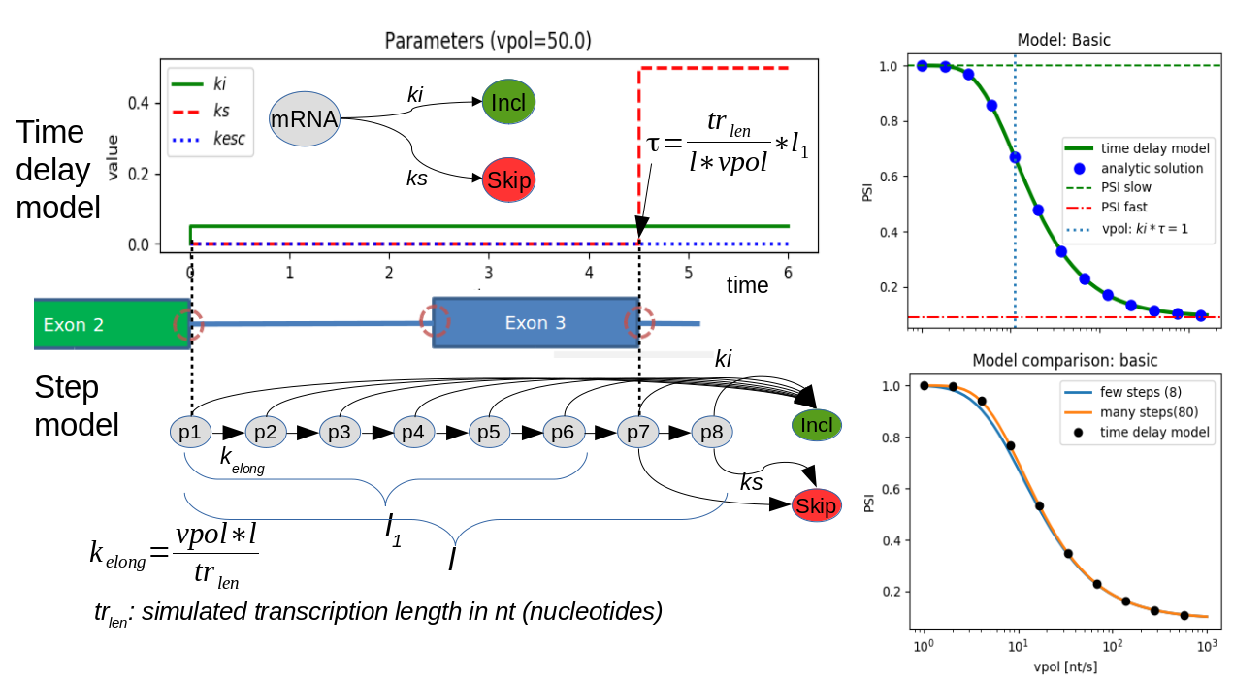
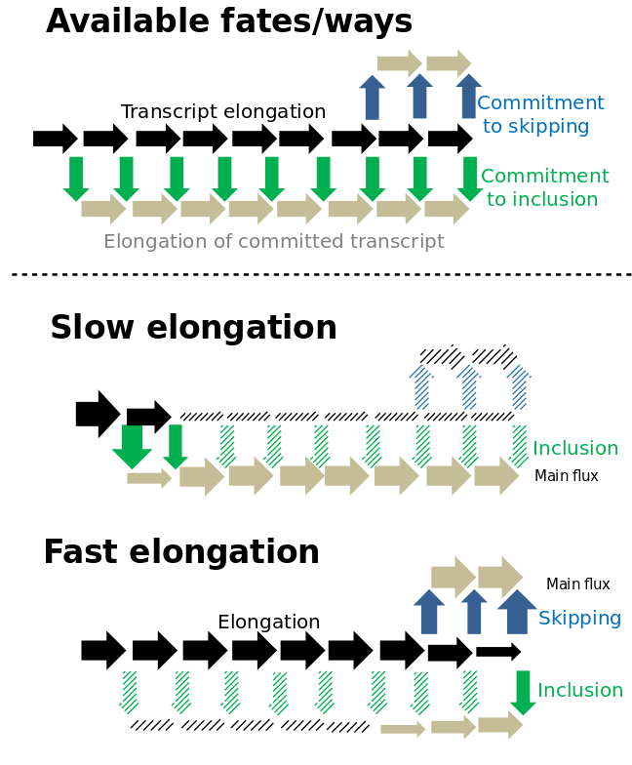
Figure 1
A
Gene expression overview
B
Co-transcriptional Splicing
5’ SS
3’ SS
P0
State
name
P1
kelong
ki
P2
Incl
P3
Transcription
P4
P5
P6
Skip
P7
ks
P8
C
Two modeling approaches
D
Results
E
Mechanism scheme

Slide 3
Figure 1 caption
Overview of co-transcriptional Splicing under the assumption of a 3-exon mini-gene.
A Simplified representation of gene splicing with two functional (Inclusion and Skipping) and one unfunctional (Retention) isoform outcomes. After a successful splicing process, either both introns are cut out one after the other (i) so that the alternative exon is retained, or both introns are cut out together with the exon in one step (ii) leading to skipping. B Illustration of relevant states and reactions for modeling of co-transcriptional splicing. The transcribed part of pre-mRNA is coloured. The elongation takes place in a step-wise manner depicted as reactions P_{i} → P_{i+1}. Considering exon definition model a splicing reaction is only possible after transcription of second exon, so the preceding elongation steps are ignored. C Comparison of two modeling approaches. The step model corresponds to B. The elongation is represented as a reaction chain of several steps. In the first 6 elongation states a commitment to skipping is possible. In the last 2 states both splicing reactions are possible. The time delay model is an abstraction of the step model. It contains in contrast to step model only three species. The elongation is simulated by a time delay τ. Before τ only the skipping reaction is possible. After τ the reaction rate constant k_{s} is turned on, so both splicing reactions can take place. These simplified models contain no retention reactions. The models were compared against each other and against a third analytical solution(Supplement). The results of the model simulations are shown on the right. The ratio PSI=Incl/(Incl +Skip) is a function of polymerase II speed vpol. The horizontal lines mark the two limit cases for vpol. The vertical blue line marks vpol at which a share of 1-e⁻¹ of pre-mRNA is spliced before τ. D Schematic representation of two limit cases for slow and fast polymerase II speed (vpol). The solid arrows show the main reaction flux, the shaded arrows typify minor or not existing fluxes.

Slide 4
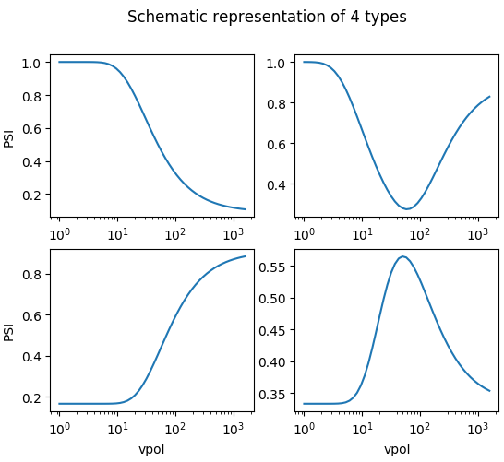
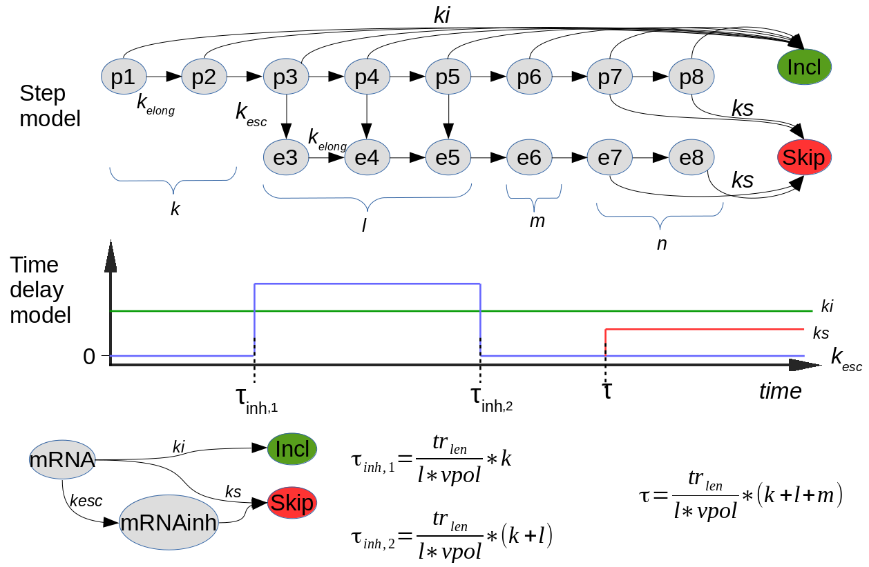
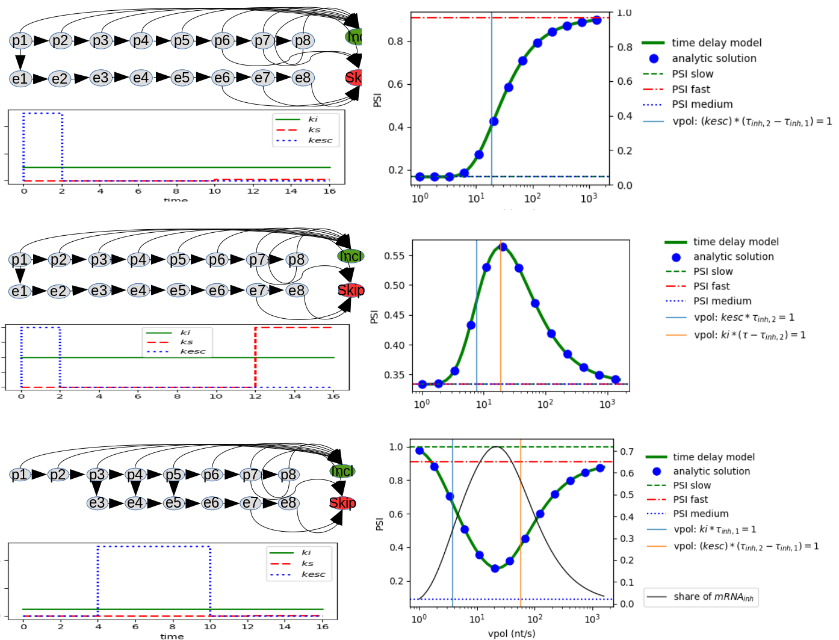
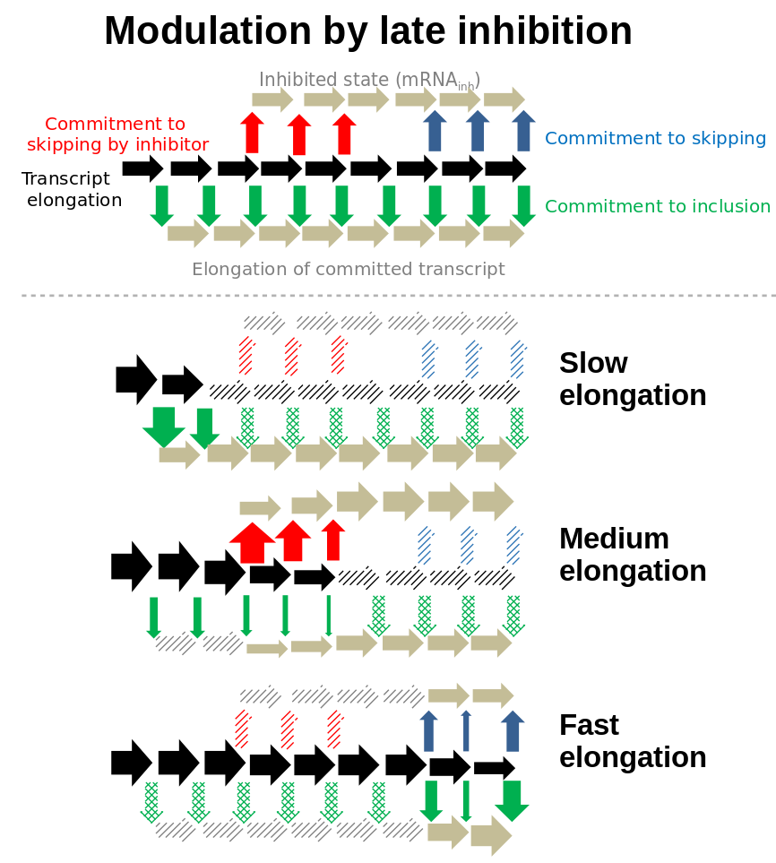
Figure 2
A
B
General model topology
C
D
(i)
(i)
(ii)
(ii)
(iii)
(iii)

Slide 5
Figure 2 caption
Extended splicing models reveal complex PSI-vpol profiles.
A Profiles observed in the literature and their schematic representations. B General definition of step model topology. The topology is defined by k, l, m, n ∈ ℕ. They represent the amount of elongation steps for each of 4 phases. k-phase: steps before inhibition/escape reaction. l-phase: window of opportunity where inhibition is possible. m-phase: steps after l-phase where skipping is still not possible. n-phase: both splicing reaction are possible. By varying of those numbers different models can be created. The time delay model is derived from given topology analogous to Fig. 1C. Compared to the basic model it contains an additional species mRNAinh representing an inhibited mRNA. Also there are two additional time delays τ_{inh,1}, τ_{inh,2} marking the window of opportunity for inhibition. C Three exemplary models showing different PSI-vpol profiles comparing to the basic (unbranched, Fig 1) model. The first two models have comparable topologies and are classified as “early inhibition” models. The main difference between them is the ratio of ks to ki in the n-phase. The third model is a “late inhibition” model. The graphs on the right show the resulting PSI-vpol profiles. The black solid line in the last plot depict the share of mRNA being inhibited (bound by inhibition RBP) during transcription. D Schematic mechanism of the third model depicted in C. On the top all feasible fates of one mRNA molecule are depicted. The lower part shows the main reaction flux considering three operation modes. The solid arrows show the main reaction flux, the shaded arrows typify minor or not existing fluxes.

Slide 6
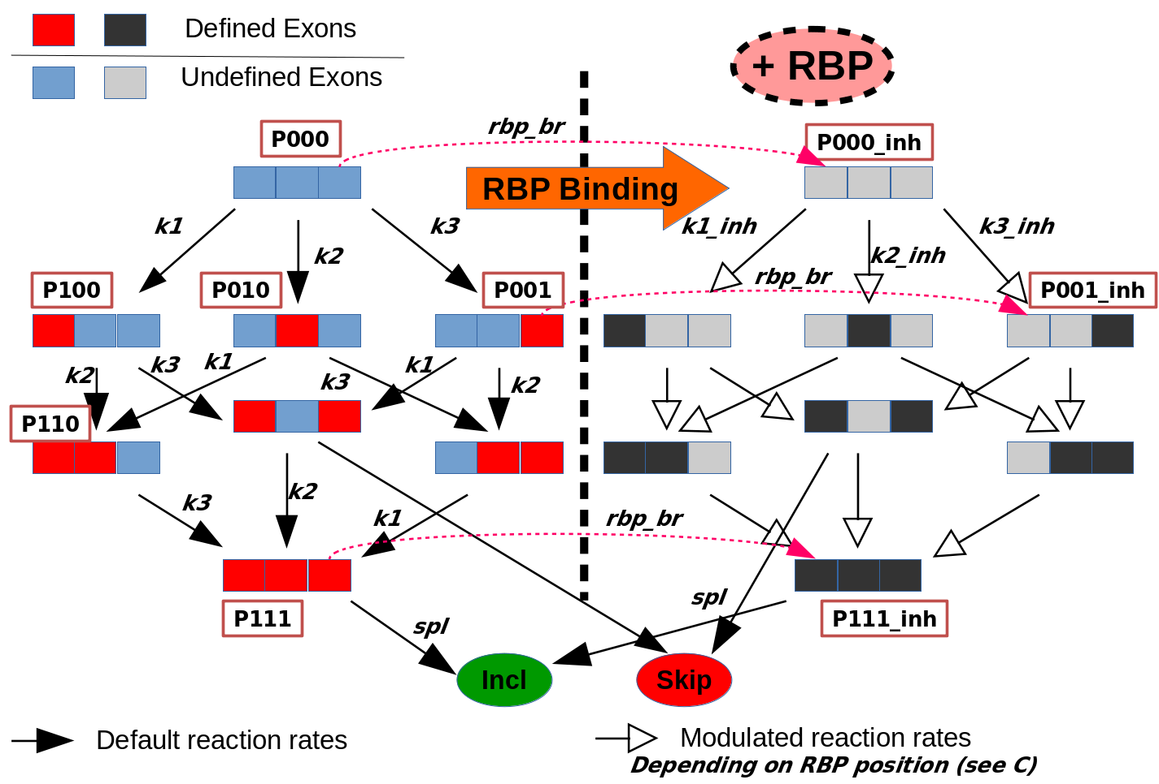
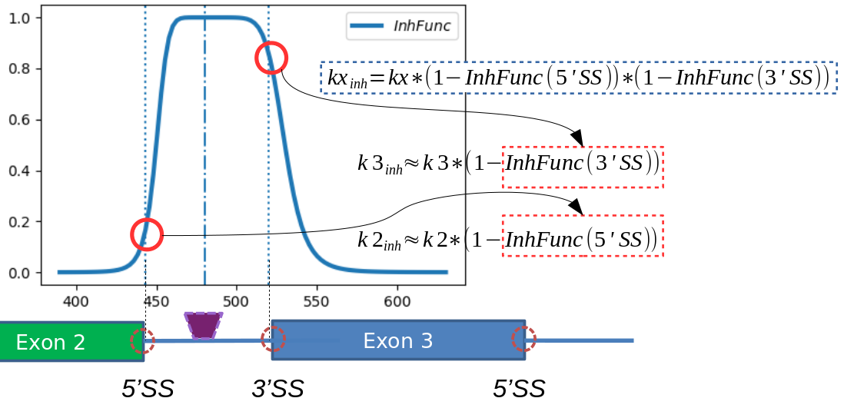
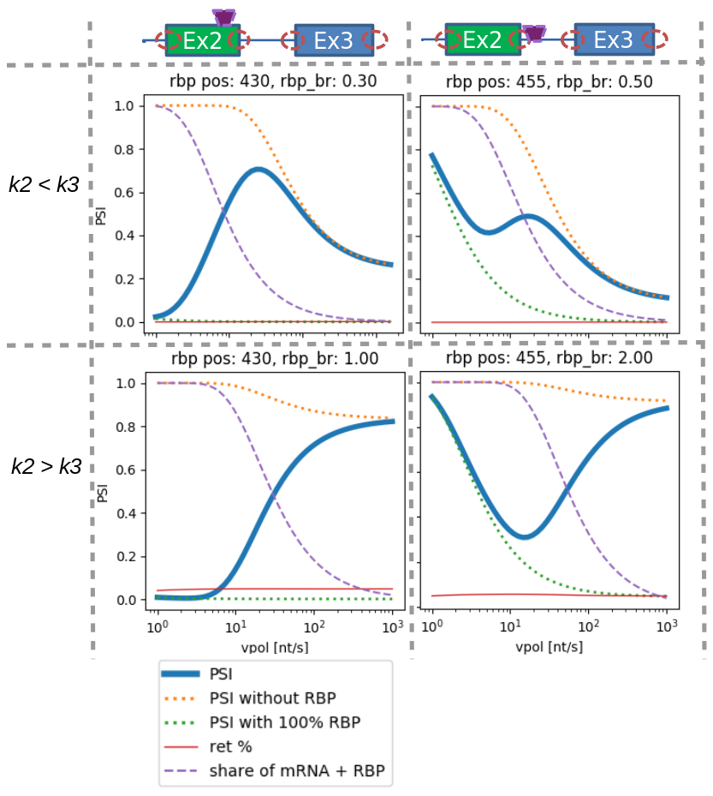
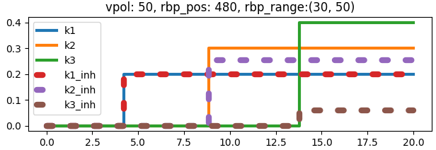
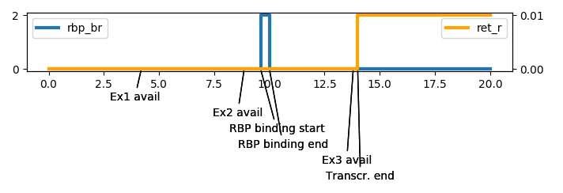
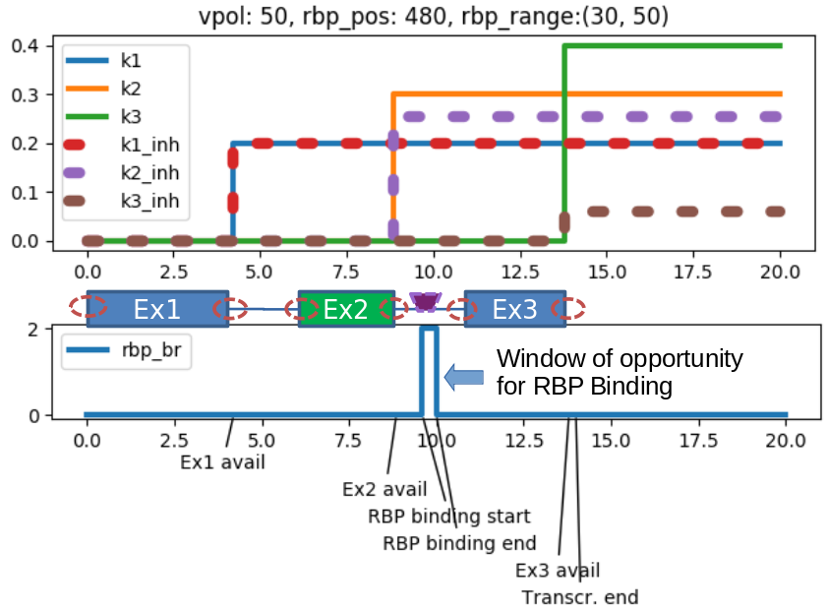
Figure 3
Reaction network
Modulation of exon definition rates
A
B
Possible vpol-PSI profiles
D
C
Time dependent parameter evolution
Ex1
Ex2
Ex3
Window of opportunity for RBP Binding

Slide 7
Figure 3 caption
Profiling of detailed mechanistic model of a 3-exon mini-gene.
A Reaction network of co-transcriptional splicing model. The network comprises two similar sub-networks with different exon definition rates. Each sub-network is a 3-exon splicing model consisting of 8 species for pre-RNA and 2 species for splicing products outcome. The 8 species represent all permutations of 3 independently defined(recognized) and undefined exons. The splicing reaction can occur when either exon1 and exon3 are recognized leading to skipping, or when all 3 exons are recognized leading to inclusion. From each binding state Pxyz a RBP binding reaction can take place leading to Pxyz_inh in the left sub-network. There is no dissociation reactions (no way from right to left sub-network). B Modulation of reaction rate constants. After RBP binding the rates for exon recognition are modulated by the inhibition function of the RBP. The inhibition function can affect both splicing sites(SS) of an exon, if both of them are within the inhibition range. C Realization of co-transcriptional behavior. Some reactions are enabled or disabled by modification of reaction rate constants after a certain time delay. The delays are determined by RNAP II speed(vpol) and gene structure. So the exon definition is only possible after an exon is completely transcribed. RBP binding occurs in a temporal widow of opportunity simulating a RNAP II associated binding reaction. D Resulting vpol-PSI profiles. The profiles can be considered as weighted sum of two limit case profiles: depicted as orange and blue dashed lines. At low RNAP II speed the profile with strong RBP binding (orange) dominates due to larger widow of opportunity for RBP binding. By increasing RNAP speed the probability for RBP binding decreases causing a larger proportion of uninhibited mRNA molecules, so that the resulting profile approximates the profile without RBP. The shape of a profile is decisively determined by the RBP binding site and by the ratio between two exon definition rate parameters k2 and k3.

Slide 8
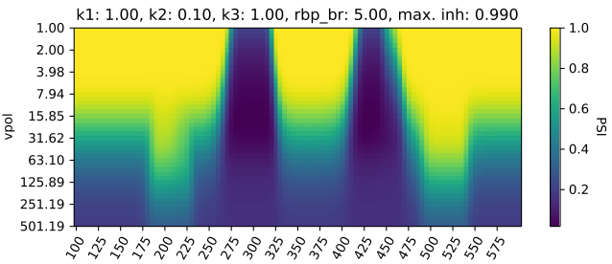
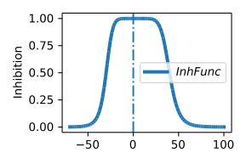
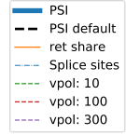
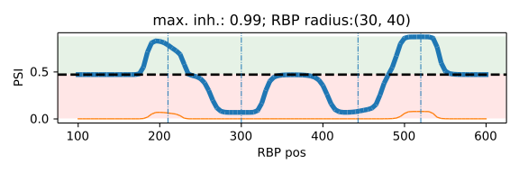
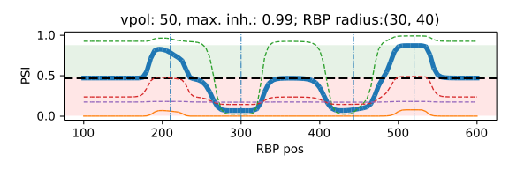
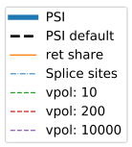
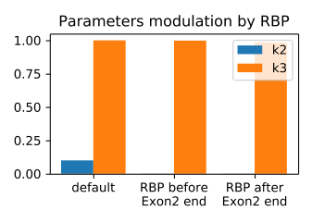
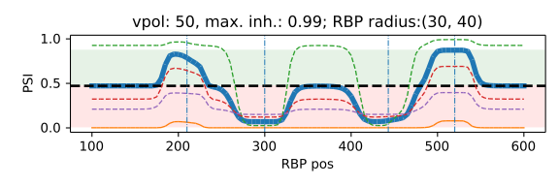
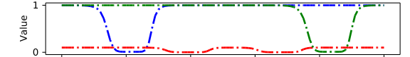
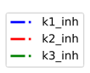
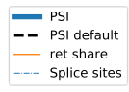
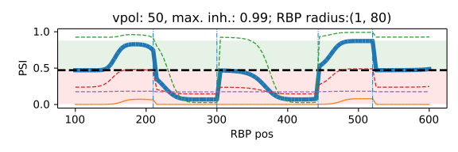
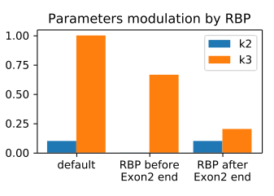
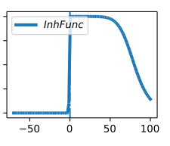
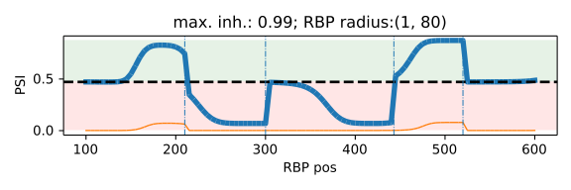
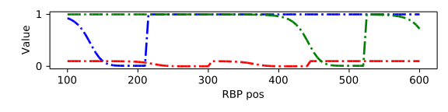
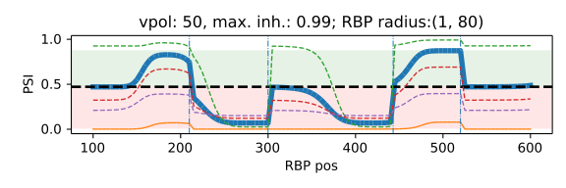
Figure 4
A
B
pos1
pos2
Ex1
Ex2
Ex3
Gene structure
C
D
pos1
pos2
E

Slide 9
Figure 4 caption
RBP position dependent splicing behavior.
A Heatmap of PSI-values as a function of RBP position and RNAP II speed (vpol). B RBP inhibition function representing the strength of binding inhibition of splicing factors (thus exon recognition) in the vicinity of a RBP (see Fig. 3B). At zero is the binding site of a RBP. In the positive direction of x-Axis is the downstream effect and in the negative direction is the upstream effect. C PSI as a function of RBP position at a certain RNAP II speed (vpol = 50 nt/s). Depending on the position of an inhibiting RBP the inclusion of the cassette exon can be inhibited (red area) or activated (green area). The activation of inclusion is accompanied by a rise of retention proportion due to a delayed exon 1 or exon 3 recognition and thus to a delayed splicing reaction. At the bottom the modulated exon definition parameter are shown. D Bar plot of parameters k2_{inh} and k3_{inh} under 3 different conditions: without RBP(default), at position 1 and at position 2 depicted on the gene structure. E PSI-RBP-position profile with a different RBP inhibition function, which features only a downstream effect. The explanations to the particular plots can be found under B, C, D.

Slide 10
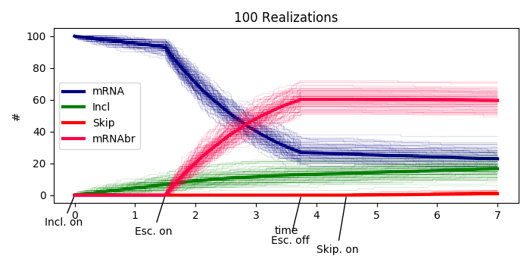
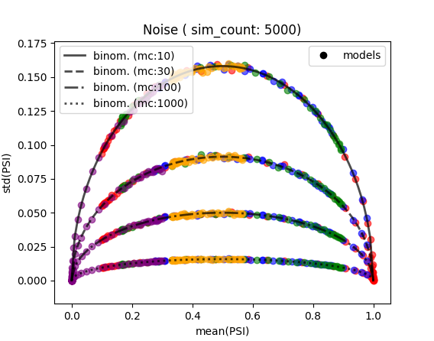
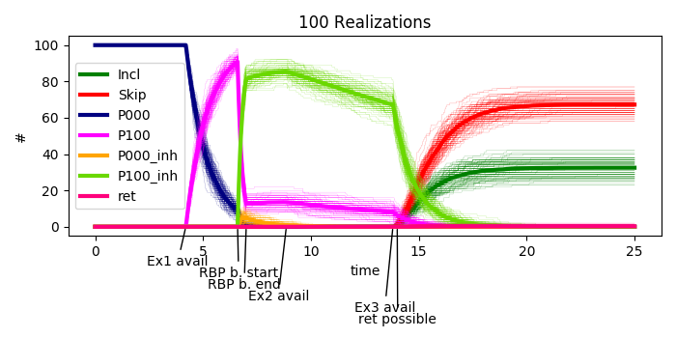
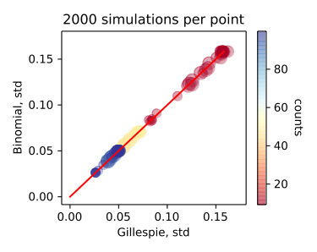
Figure 5
Time courses, chain model
B
Variation of PSI value
A
Time courses, mechanistic model
D
Variation of PSI value
C
Ex1
Ex2
Ex3

Slide 11
Figure 5 caption
Investigation of Intrinsic noise resulting from stochastic simulation.
A Time course of the time delay model corresponding to topology depicted in Fig. 2C (iii). The RNAP II speed (vpol) is set to 50 nt/s. The graph shows 100 simulations of Gillespie algorithm and their mean value (thick line). Each realization results in a different PSI-value (Incl/(Incl+Skip)) at the end of simulation (the graph shows only the first seconds of simulation). At the bottom the time delays in their names are annotated. B Standard deviation of PSI value as a function of mean(PSI) for all model topologies in Fig. 2C (different colors) and various amounts of molecules. Different PSI-values were generated by the variation of vpol. For a stable calculation of standard deviation, 5000 simulation per point were performed. The standard deviation of the resulting PSI is compared to std of binomial distribution and is in accord with it. C Time course for some species of the mechanistic model depicted in Fig. 3A. The Details are analogous to A. D Comparison of std(PSI) between Gillespie simulation and binomial distribution. The point colors indicate the sum of Incl and Skip at the end of a simulation (it may vary due to retention reaction). The point size denote the mean(PSI). 2000 simulations per point were performed. Different PSI-values were generated by the variation of vpol. It was done for 3 different initial amount of molecules (10, 50, 100).

Slide 12
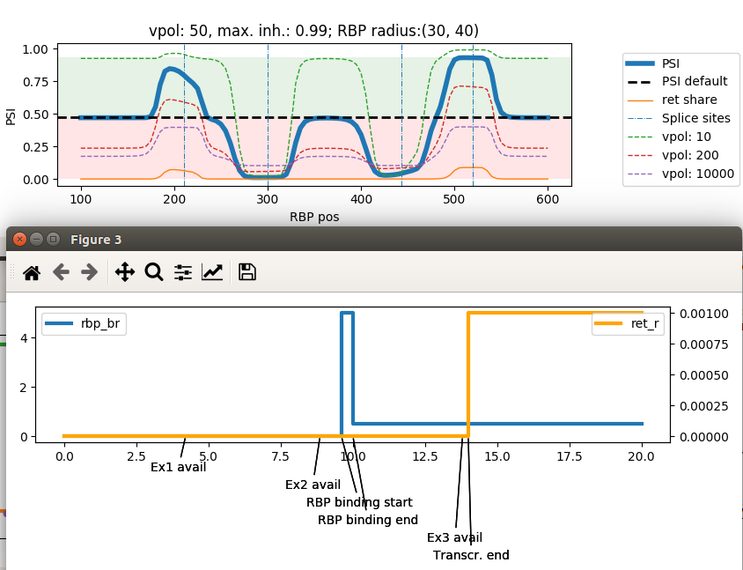
With basal RBP binding rate

Slide 13
Ignore next slides

Slide 15
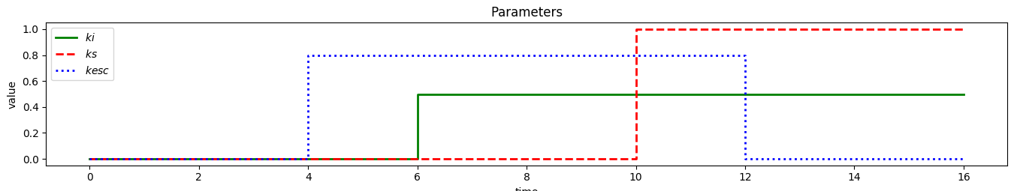
Alternative topology definition
l : whole chain length
k : first steps where inclusion is not possible
m1 : first steps where inhibition is not possible
m2 : steps where inhibition is possible
n : last steps where inclusion and skipping are possible
l
k
kelong
ki
p1
p2
p3
p4
p5
p6
p7
p8
Incl
kesc
ks
e3
kelong
e4
e5
e6
e7
e8
Skip
ks
m1
m2
n

Slide 16
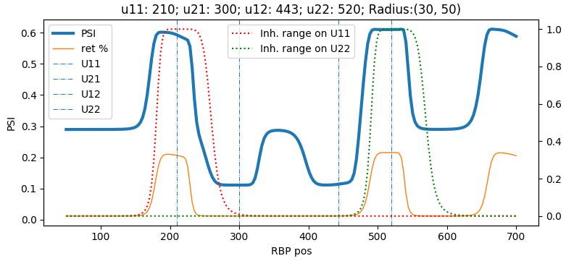
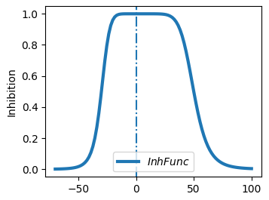
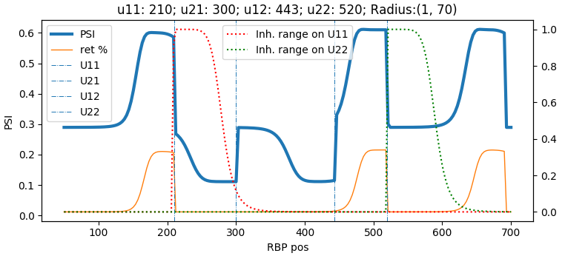
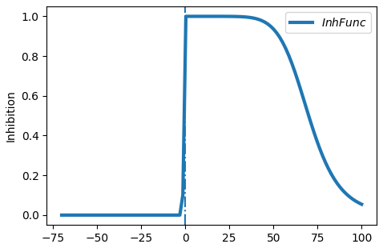
Figure 4B
Inhibition range
Ex1
Ex2
Ex3

Slide 17
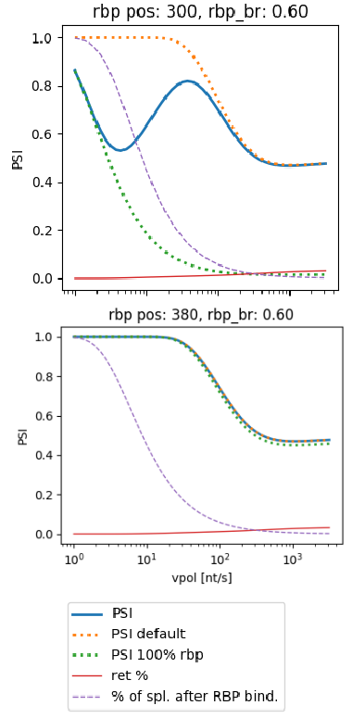
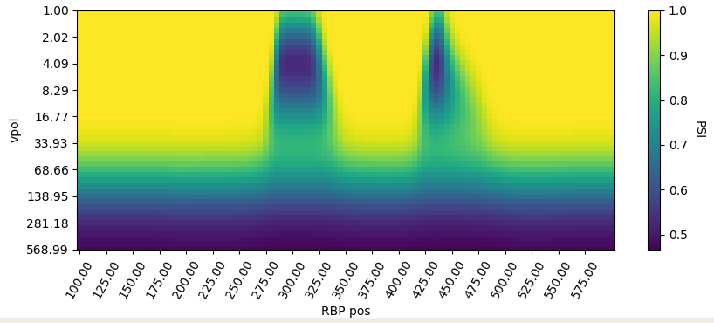
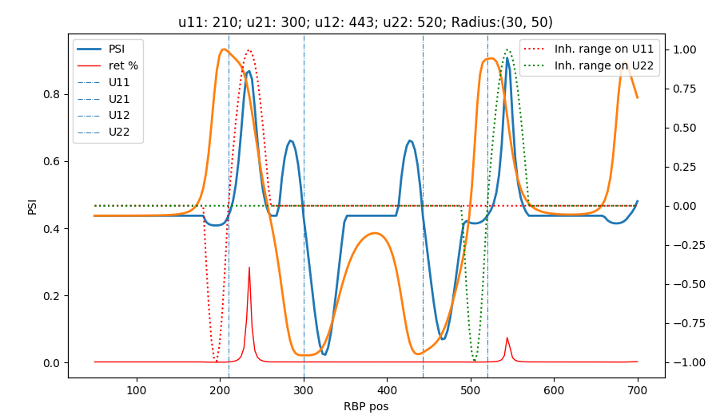
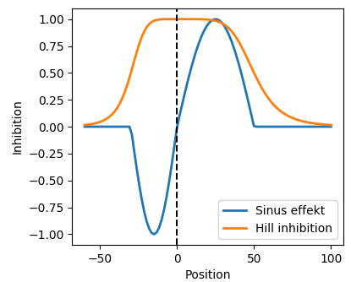
Figure 4
(i)
(ii)
(i)
(iii)
(ii)
Ex1
Ex2
Ex3
(iii)

Slide 18
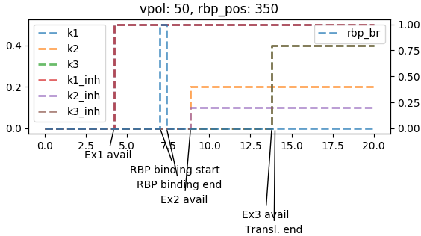
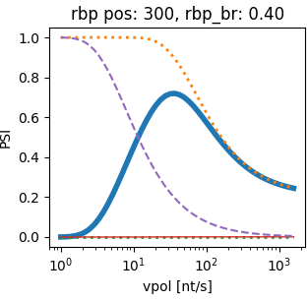
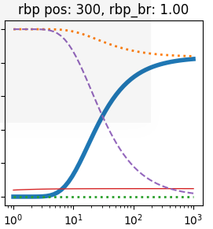
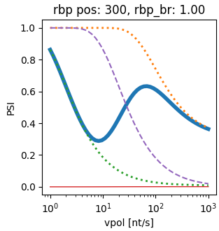
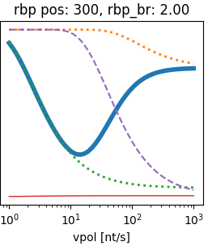


Ex1
Ex2
Ex3

